Slide 1
HEAPS
An implementation of Priority Queues

Slide 2
Motivation for Priority Queues
Multiple jobs in queue for printing
  One page job should have priority over 100 page job
Similarly, jobs wait to get processed in a multitasking environment
  Some jobs are time critical
Such type of applications require a special type of queue, known as heaps (priority queue)

Slide 3
Basic model of Heap
This data structure requires at least two operations
  insert()
  delete_min()
    Assumption: minimum values means highest priority
HEAP
(PRIORITY QUEUE)
delete_min()
Insert()

Slide 4
Implementations
There are several ways to implement a heap, e.g.,
  Using a linked list.
    Insert at end is O(1)
    Traverse to serach min n delete is O(n)
  Or using a sorted liked list
    Insertion get expensive O(n) as suitable location is searched
    Delete frist values - O(1)

Slide 5
Implementation (cont.)
  Using BST
    both operations take log n time on average
    Repeatedly removing the minimum elements will unbalance the tree,
    this can be avoided by making sure to keep the tree balanced

Slide 6
Old Terminologies
Depth of a Tree
  Depth of a tree is the maximum depth of any of its leaves.
    Note: depth and height means one and the same thing
Full Binary Tree
  Every leaf has the same depth, and every non-leaf has two children
Complete binary tree
  All the depth levels are full, except the deepest, where the nodes are as far left as possible

Slide 7
Depth of a node
nodes
Depth 0
Depth 1
Depth 2
Depth 3

Slide 8
Full Binary Tree
nodes

Slide 9
Complete Binary Tree
nodes

Slide 10
Binary Heap
Usually Heap means binary heap
Heaps have two properties
  Heap is a complete binary tree
  For every node X, the key in the parent of X is smaller than the key in X

Slide 11
23 13 44 65 3 5 6 33 23 98 11

Slide 12
Example
1
1
2
3
2
3
4
5
6
7
4
5
6
8
9
10
11
12
13
7
8
9
10
11
12

Slide 13
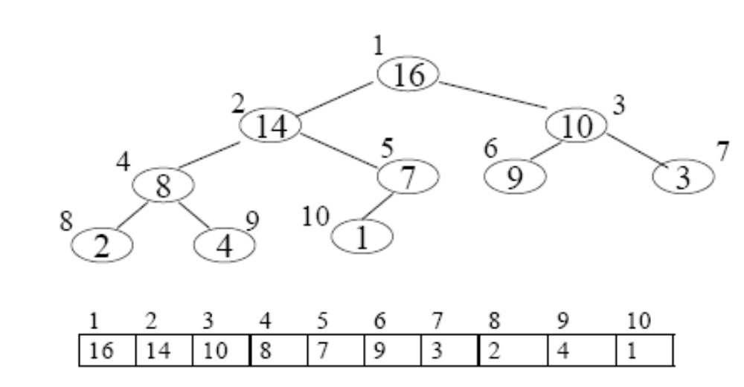
Array representation
Arrays are very easily used to represent complete binary trees
Example

Slide 14
Array representation
Root always appear at array[1]
Suppose non-root node at location array[i], then the data for its parents is always at location array[ i / 2]
Similarly data for its children is always at the following location
  Left child at array[2i]
  Right child at array[2i+1]
These formulas make it easy to implement algorithms that traverse the tree

Slide 15
Basic Heap Operations
Insert
Delete_Min

Slide 16
13
Insert 14
21
16
24
31
19
68
65
26
32
13
21
16
24
31
19
68
65
26
32

Slide 17
13
21
16
24
19
68
65
26
32
31
13
16
24
21
19
68
65
26
32
31

Slide 18
13
14
16
24
21
19
68
65
26
32
31

Slide 19
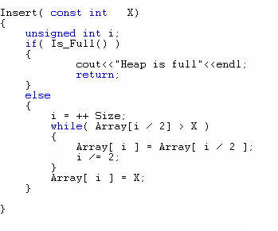
struct Person {string name; int age; string gender;}

Slide 20
Delete_Min Example
13
14
16
19
21
19
68
65
26
32
31
14
16
19
21
19
68
65
26
32
31

Slide 21
14
16
19
21
19
68
65
26
32
31
14
19
16
21
19
68
65
26
32
31

Slide 22
14
19
16
26
21
19
68
65
32
31
14
19
16
26
21
19
68
65
31
32

Slide 23
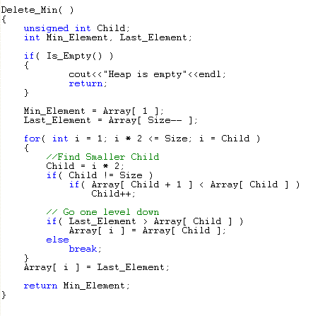

Slide 24
Analysis
Insert
  O(logn)
    If the new item inserted is the new minimum
Delete_Min
  O(logn)

Slide 25
Another kind of heap
Max_heap
  Parent has higher value than its children
  Therefore the root has the highest value

Slide 26
Reference
Section 6.1, 6.2 & 6.3 of
  Data Structures and Algorithm Analysis in C++
    by Mark Allen Weiss

Slide 27
Another kind of heap
Max_heap
  Parent has higher value than its children
  Therefore the root has the highest value

Slide 28
How to build a heap?
Build_heap
  Also known as heapify
  Start from the second last level, and check the condition of heap by comparing it with its children
  If needs arise swap the values

Slide 29
Example: building a max_heap (1)
1 2 3 4 5 6 7 8 9 10
1
4 | 1 | 3 | 2 | 16 | 9 | 10 | 14 | 8 | 7
4
2
3
1
3
4
5
6
7
2
16
9
10
8
9
10
14
8
7

Slide 30
Example: building a heap (2)
1
4
2
3
1
3
4
5
6
7
2
16
9
10
8
9
10
14
8
7

Slide 31
Example: building a heap (4)
1
4
2
3
1
3
4
5
6
7
14
16
9
10
8
9
10
2
8
7

Slide 32
Example: building a heap (5)
1
4
2
3
1
10
4
5
6
7
14
16
9
3
8
9
10
2
8
7

Slide 33
Example: building a heap (6)
1
4
2
3
16
10
4
5
6
7
14
7
9
3
8
9
10
2
8
1

Slide 34
Example: building a heap (7)
1
16
2
3
14
10
4
5
6
7
8
7
9
3
8
9
10
2
4
1

Slide 35
Heapsort
Heapsort(A)
1. Build-Max-Heap(A)
2. for i ← length[A] down to 2
3. A[i] ← Delete_Max( )
Keep in mind that the largest element is at the root.
Delete_Max() is O(lg n), but is executed n times,
so runtime for Heapsort(A) is
O(nlgn) for all Delete_Max and
O(nlgn) for Build_Max_Heap
Total O(nlgn)

Slide 36
Example: Heap-Sort
1
16
2
3
14
10
4
5
6
7
8
7
9
3
8
9
10
2
4
1
16 | 14 | 10 | 8 | 7 | 9 | 3 | 2 | 4 | 1

Slide 37
Example: Heap-Sort (2)
1
14
2
3
8
10
4
5
6
7
4
7
9
3
8
9
10
2
1
16
16 | 8 | 10 | 4 | 7 | 9 | 3 | 2 | 1 | 16

Slide 38
Example: Heap-Sort (3)
1
10
2
3
8
9
4
5
6
7
4
7
1
3
8
9
10
2
14
16
10 | 8 | 9 | 4 | 7 | 1 | 3 | 2 | 14 | 16

Slide 39
Example: Heap-Sort (4)
1
9
2
3
8
3
4
5
6
7
4
7
1
2
8
9
10
10
14
16
9 | 8 | 3 | 4 | 7 | 1 | 2 | 10 | 14 | 16

Slide 40
Example: Heap-Sort (4)
1
8
2
3
7
3
4
5
6
7
4
2
1
9
8
9
10
10
14
16
8 | 7 | 3 | 4 | 2 | 1 | 9 | 10 | 14 | 16

Slide 41
Example: Heap-Sort (5)
1
7
2
3
4
3
4
5
6
7
1
2
8
9
8
9
10
10
14
16
7 | 4 | 3 | 1 | 2 | 8 | 9 | 10 | 14 | 16

Slide 42
Example: Heap-Sort (6)
1
4
2
3
2
3
4
5
6
7
1
7
8
9
8
9
10
10
14
16
4 | 2 | 3 | 1 | 7 | 8 | 9 | 10 | 14 | 16

Slide 43
Example: Heap-Sort (7)
1
3
2
3
2
1
4
5
6
7
4
7
8
9
8
9
10
10
14
16
3 | 2 | 1 | 4 | 7 | 8 | 9 | 10 | 14 | 16

Slide 44
Example: Heap-Sort (8)
1
2
2
3
1
3
4
5
6
7
4
7
8
9
8
9
10
10
14
16
2 | 1 | 3 | 4 | 7 | 8 | 9 | 10 | 14 | 16

Slide 45
Data is now sorted
1 | 2 | 3 | 4 | 7 | 8 | 9 | 10 | 14 | 16

Slide 46
Reference
Section 6.1, 6.2 & 6.3 of
  Data Structures and Algorithm Analysis in C++
    by Mark Allen Weiss

